Slide 1
Project 4 “Real World” data
IE 4910
By: James Sloan

Slide 2
Supply Chain deliveries
137 Columns
93379 Rows

Slide 3

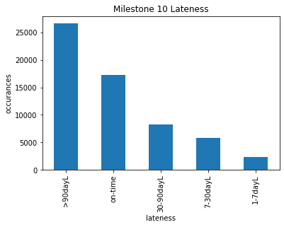

Target data (to predict)
Whether or not the Milestone 10 target date was hit
Calculated the lateness in days and categorized:
“on-time” – 0 days late or early
“1-7dayL” – 1 to 7 days late
“7-30dayL” – 7 to 30 days late
“30-90dayL” – 30 to 90 days late
“>90dayL” – more than 90 days late
Most are on time or very late
Large majority are late

Slide 4
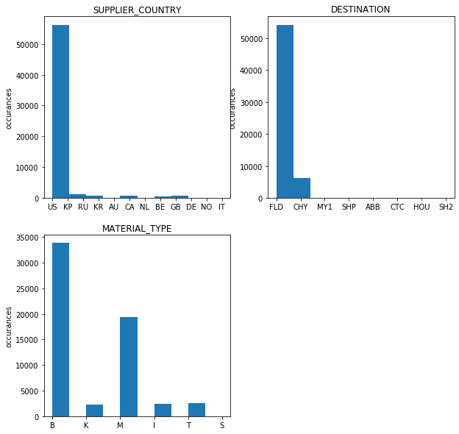
Categorical Predictors
Kept three categorical columns
Most suppliers are in the US
Most destinations are FLD
Most material type is B or M

Slide 5

Feature Engineering
Dates are mostly irrelevant for prediction
We only have data for dates that we will never visit again
Calculated various time-deltas to use as predictors:
“MS1_Delta” = Milestone 1 schedule - actual
“MS2_Delta” = Milestone 2 schedule - actual
“MS3_Delta” = Milestone 3 schedule - actual
“PO_Delta” = PO issued - created
“Schd_Rng” = Milestone 10 schedule – milestone 1 schedule
“SOP-MS1_Delta” = SOP – Milestone 1 actual
“SOP-MS2_Delta” = SOP – Milestone 2 actual
“RAS-MS1_Delta” = RAS – Milestone 1 actual
“RAS-MS2_Delta” = RAS – Milestone 2 actual

Slide 6
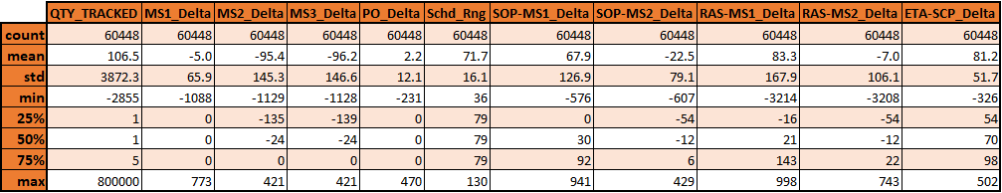
Continuous Predictors summary
After removing nulls: 60,448 rows remained
Negative MS#_Delta corresponds to being behind schedule
MS1, MS2, MS3 are all late on average
Average scheduled project length is 71 days

Slide 7
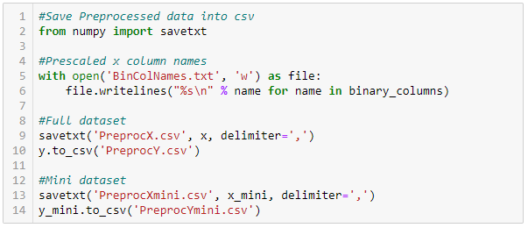

Preparing data for analysis
Saved the preprocessed data to files so each model could be an independent .ipynb
Any change to data file updates in all models
Shape was checked after each import to ensure smooth transfer
Continuous data was scaled using “StandardScaler” & Categorical data was binary encoded using “get_dummies”
All parameter tuning done with “x_mini” & “y_mini” which are a 10% random sample
All parameter tuning done at 20% test / train split

Slide 8



Decision Tree Analysis

Slide 9
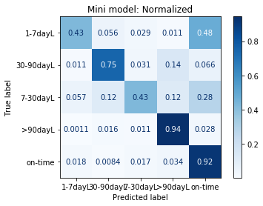
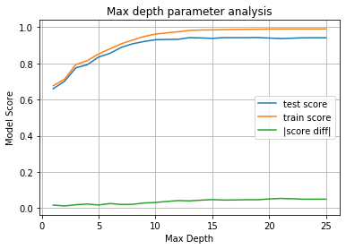
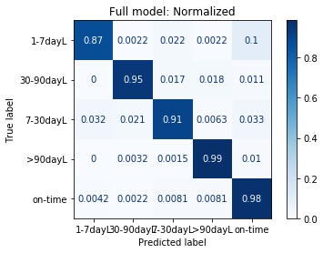
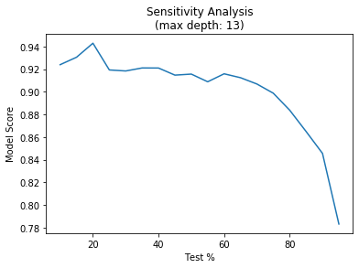
Dt Analysis summary
Confusion Matrices
Param Analysis
Mini model:
“on-time” correct 92%
Accuracy = 84.4%
Full model:
“on-time” correct 98%
Accuracy = 96.7%
Max depth:
Chose 13, local max with <4% test / train difference
Sensitivity analysis:
Fairly stable up to 60% test
Stayed at 20% test

Slide 10

Random Forest Analysis

Slide 11
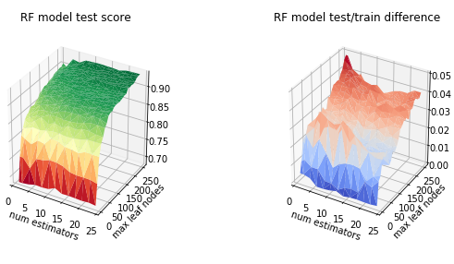
Rf Param Analysis
Maximizing test score:
The graph (left) shows the relationship between score and the two parameters.
After 5, the effect of num est. decreases
After 100, the effect of max leaf nodes decreases
Minimizing test/train difference:
The graph (right) shows the relationship between overfitting and the two parameters.
Overfitting decreases as num est. increases
Overfitting increases as max leaf nodes increases
Choosing Params:
Tried to strike a balance between good model score, low overfitting, and computing time.
Num estimators = 20
Max leaf nodes = 100

Slide 12
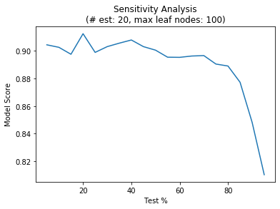
Rf Sensitivity Analysis
As before, this was run on x_mini and y_mini
Remained stable until after 80% test
Even at 95% test, accuracy was ~80%
Stayed with 20% test

Slide 13
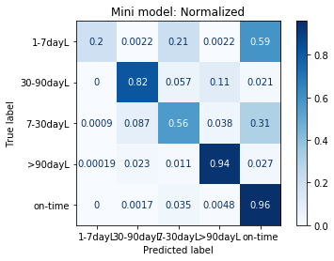
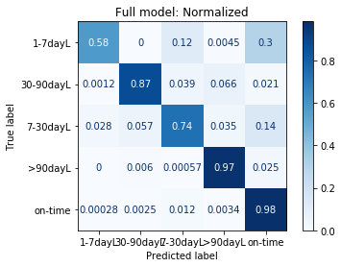
Rf Confusion Matrices
Mini model (top):
Predicted “on-time” correctly 96% of the time
Overall accuracy of 86.6%
Full model (bottom):
Predicted “on-time” correctly 98% of the time
Overall accuracy of 92.4%
While both models predicted “on-time” very well, the full model was much better at predicting the degree of lateness that would occur.

Slide 14
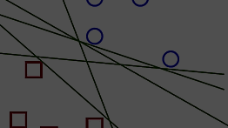
Support vector machine analysis

Slide 15
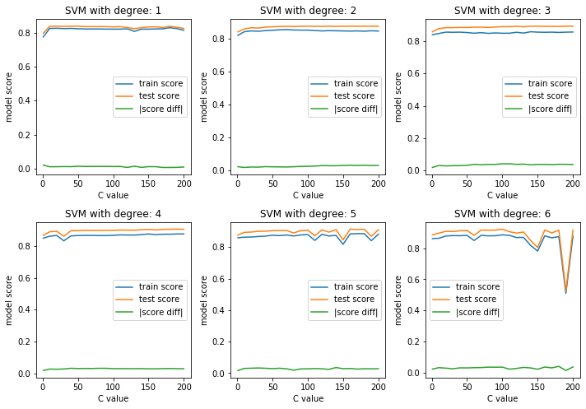
Svm param analysis
Choosing polynomial degree:
Balancing stability with accuracy
Max accuracy increases with degree
Model stability starts to be effected when degree > 4
Chose degree = 4
Choosing C:
Computation time increases exponentially with C
Accuracy increases slightly with C
Chose C = 150
Local score maximum and local score difference minimum

Slide 16
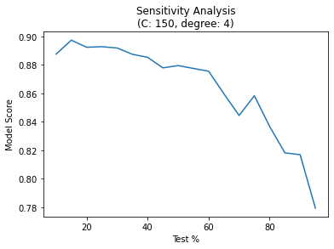
SVM Sensitivity Analysis
As before, this was run on x_mini and y_mini
Remained stable until after 60% test
Even at 95% test, accuracy was ~78%
Stayed with 20% test

Slide 17
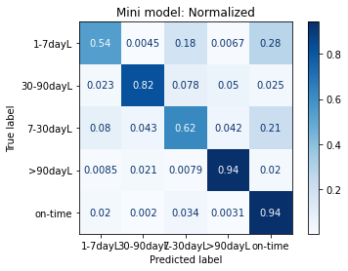
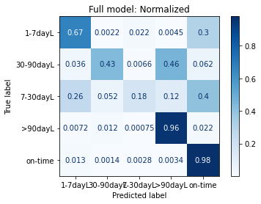
SVM Confusion Matrices
Mini model (top):
Predicted “on-time” correctly 97% of the time
Overall accuracy of 87.2%
Full model (bottom):
Predicted “on-time” correctly 98% of the time
Overall accuracy of 81.0%
Appearances of the mini model being better are likely due to computational constraints
Had to limit algorithm run time with: (max_iter=40000)
More impactful on larger model size

Slide 18

Neural Network Analysis

Slide 19
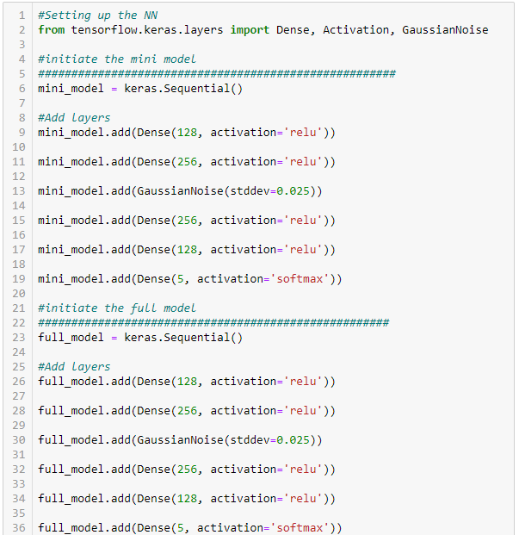
Building the model architecture
Same architecture for mini and full models
4x large Dense layers:
128 nodes (relu)
256 nodes (relu)
256 nodes (relu)
128 nodes (relu)
1x Gaussian Noise layer:
Adds variation to prevent overfitting
std. dev of 0.025
1x Dense output layer:
5 nodes (softmax)

Slide 20
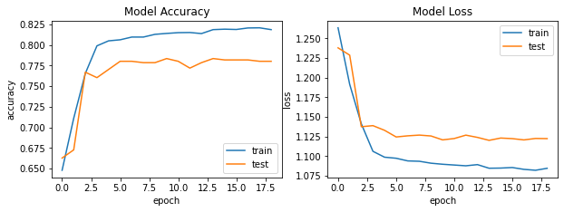
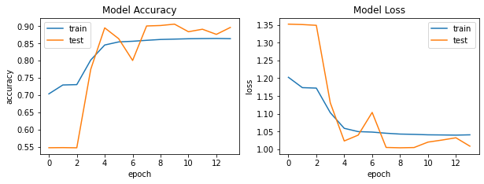
NN Model Training
Mini Model
Mini model:
Trained on the 10% subset of full data
Used 10% of subset for validation
Surprisingly more stable than the full model, even after re-running several times.
Validation accuracy plateaued around 78%
Full model:
Trained will 100% of the data
Used 10% of subset for validation
Better overall accuracy but more erratic
Plateaued around 88% accuracy
Full Model

Slide 21
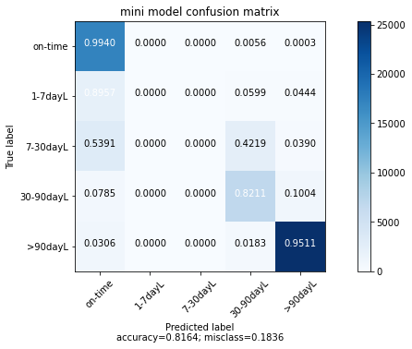
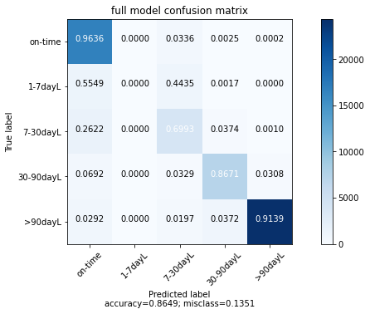
Evaluating NN Performance
Evaluated both models on the full dataset
Both models failed to predict a single 1-7dayL
The mini model also failed to predict and 7-30dayL
Mini model accuracy = 81.64%
>95% accuracy for on-time and >90dayL
Full model accuracy = 86.49%
Much better prediction of 7-30dayL
Slightly lower accuracy on >90dayL and on-time
Overall, the full model is a more reliable predictor

Slide 22
Method Comparisons
NN(full) SVM(mini) RF(full) DT(full)
acc = 86.5% acc = 87.2% acc = 92.4% acc = 96.7%
Full model performed better with every method except SVM.
DT did the best, NN did the worst
To make predictions, use an ensemble of these 4 methods

Slide 23
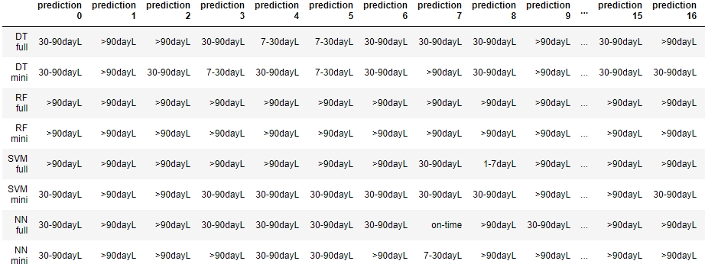
Using models & Making Predictions
Use ensemble of all 8 models
Periodically update accuracy scores as more data is collected
Update models on new data if/when average accuracy falls below 85%
Making predictions on random data:

Slide 24
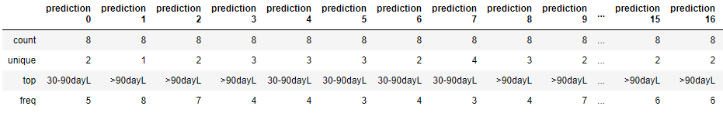

Making Decisions
Since prediction data is organized as pandas df:
Simply use and take “top” prediction
Frequency shows how many models agree with this prediction

Slide 25
Thanks for a great semester!
Stay healthy and have a great summer ☺

